Slide 1
Restaurant Rewards Mobile App
Scan. Earn. Redeem.

Slide 2
Problem / Opportunity
Customers often forget or lose loyalty cards. Restaurants struggle to track repeat customers.
Our solution: a mobile app that rewards users by scanning QR codes at partner restaurants.

Slide 3
Solution Overview
Users scan a QR code on their bill or receipt.
Points are automatically added to their account.
Points can be redeemed for discounts or rewards.
This encourages customer loyalty and return visits.

Slide 4
Key Features
• QR Code Scanning at restaurant checkout
• Automatic points addition
• Real-time points balance dashboard
• Rewards redemption catalog
• Restaurant admin analytics dashboard

Slide 5
User Journey
1. Customer dines at restaurant.
2. Scans QR code using the app.
3. Points are credited instantly.
4. Customer can redeem rewards anytime.
5. Restaurant tracks user engagement.

Slide 6
Technology Stack
• Mobile App:.NET MAUI
• Backend: ASP.NET Core
• Database: MySQL/Sql Server or Firebase
• QR Code: ZXing or Google ML Kit
• Cloud Hosting: Azure or AWS

Slide 7
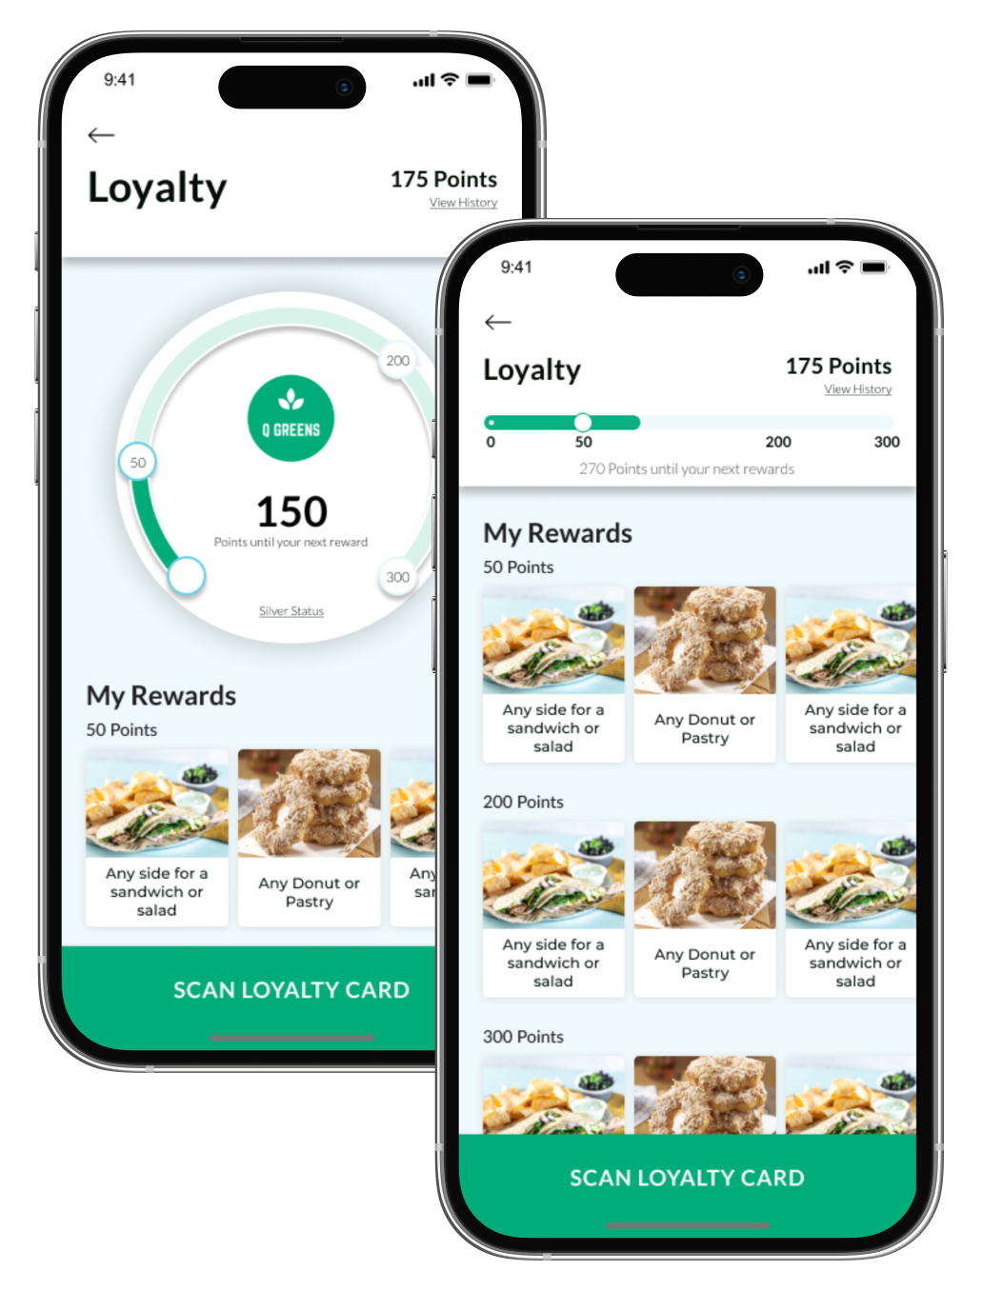
Sample Screenshots

Slide 8
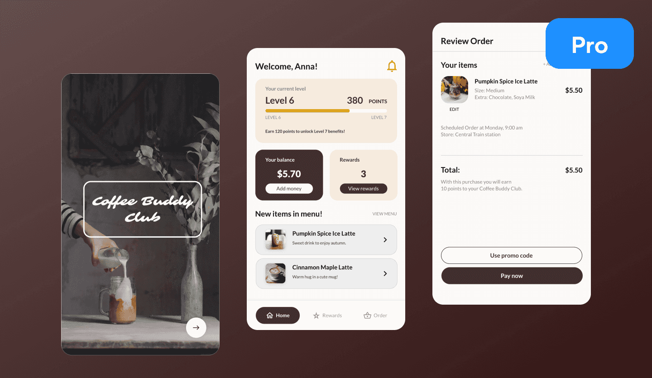
Sample Screenshots

Slide 9
Sample Screenshots

Slide 10
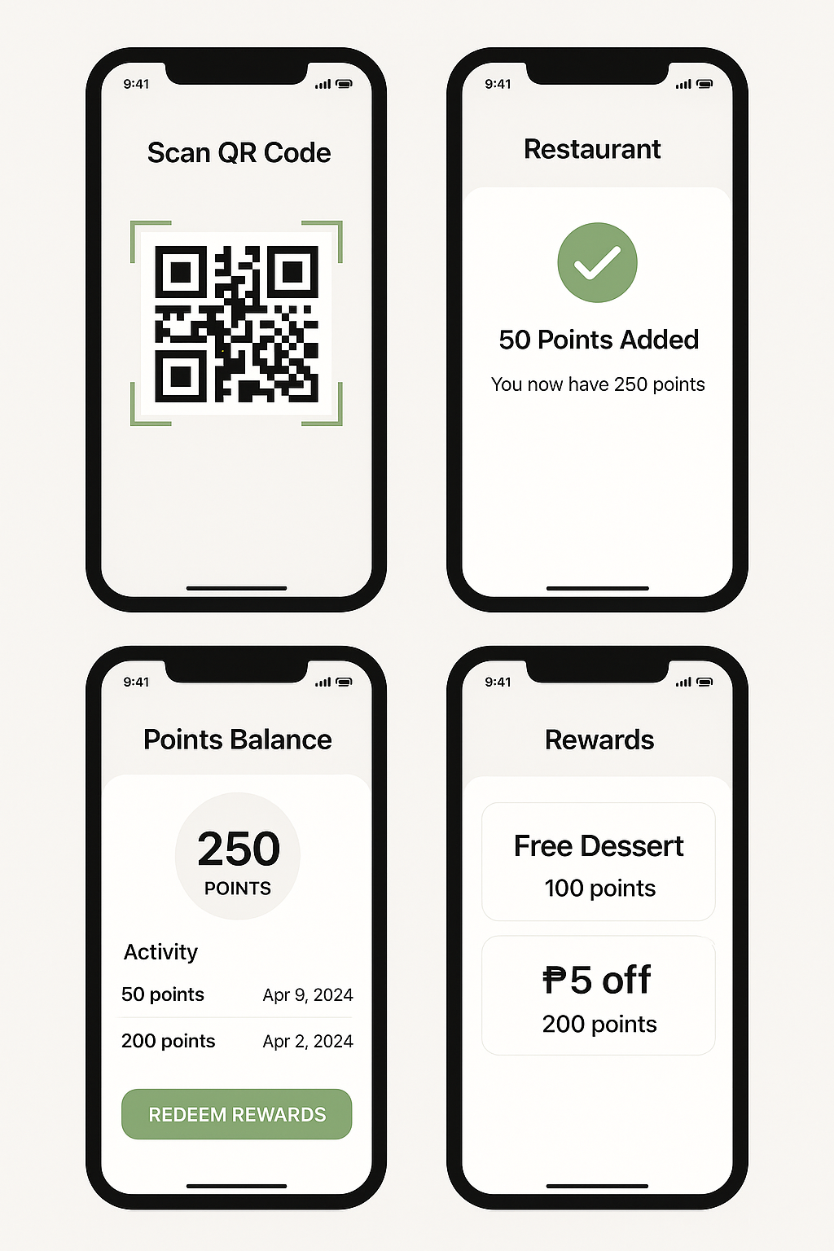
Sample Screenshots

